Slide 1

TechnoBabel

Slide 2
Overview
Project Introduction
Project Purpose, Scope, Objective
Team Organization
Problem Resolution
Project Plan
Configuration Management
Tech Stack

Slide 3

Project Introduction
Problem: Company Employees are not fully aware of their company’s terminology
Solution: A mobile app that listens to conversations and makes the employee aware of used terms and acronyms

Slide 4
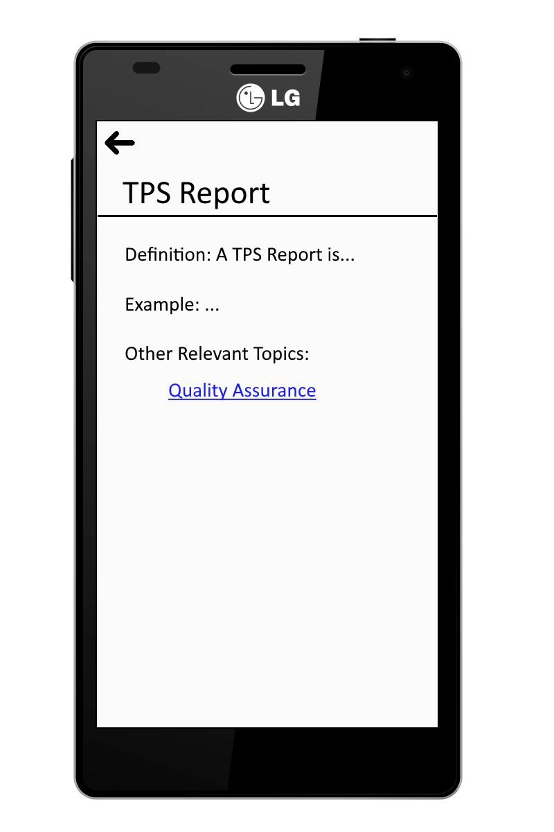
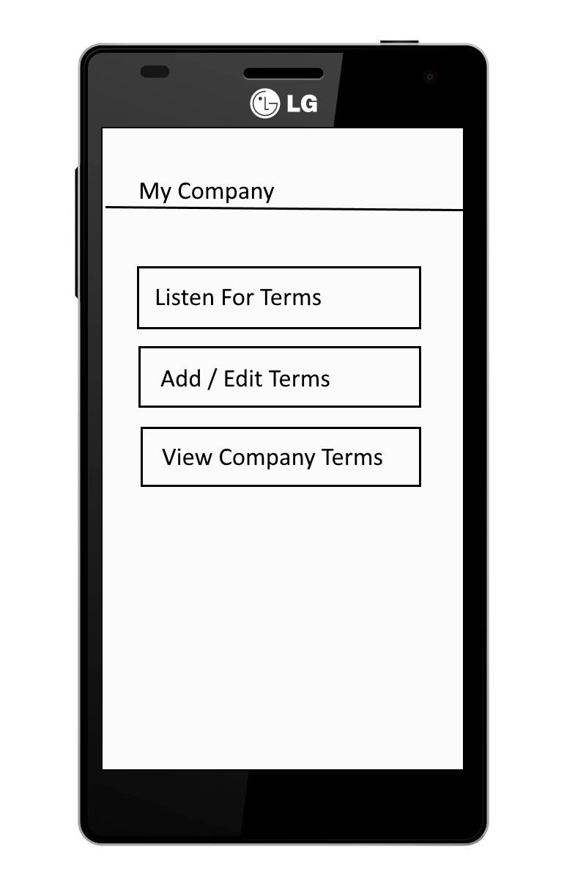

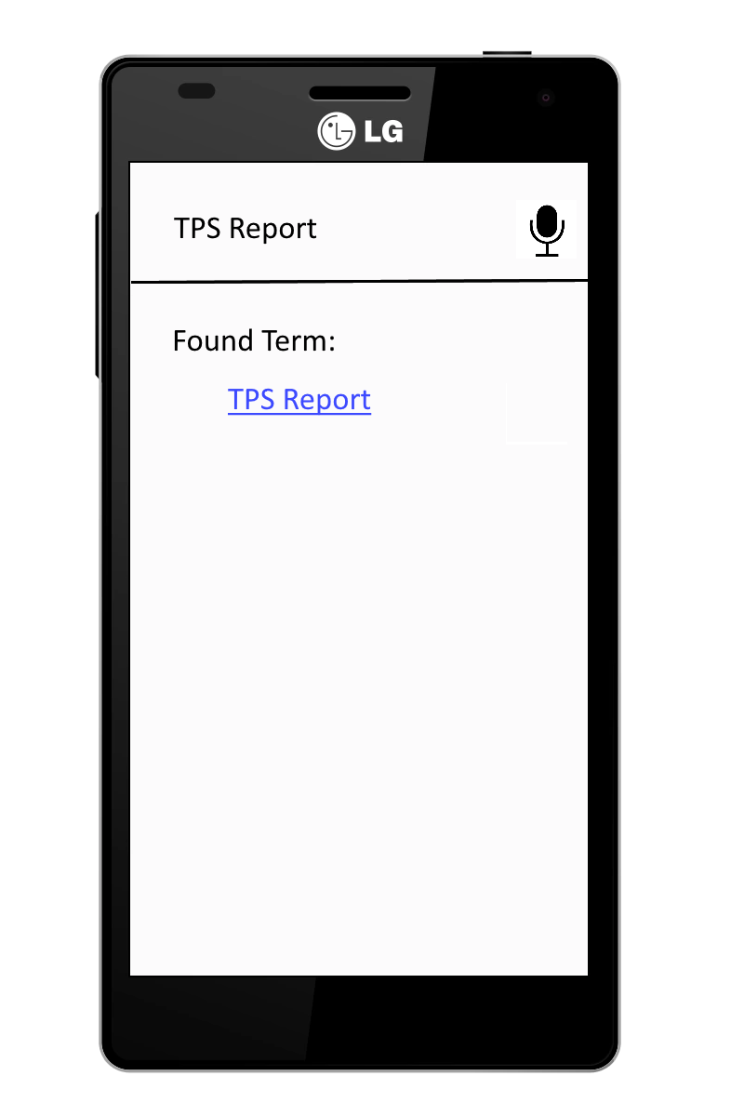
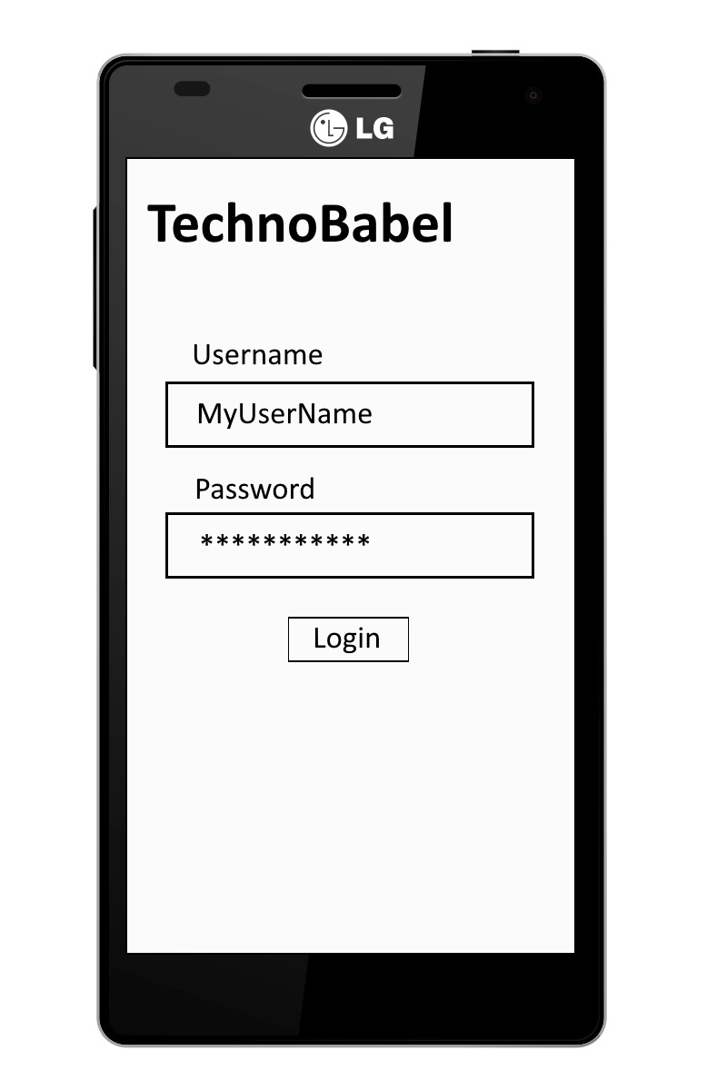
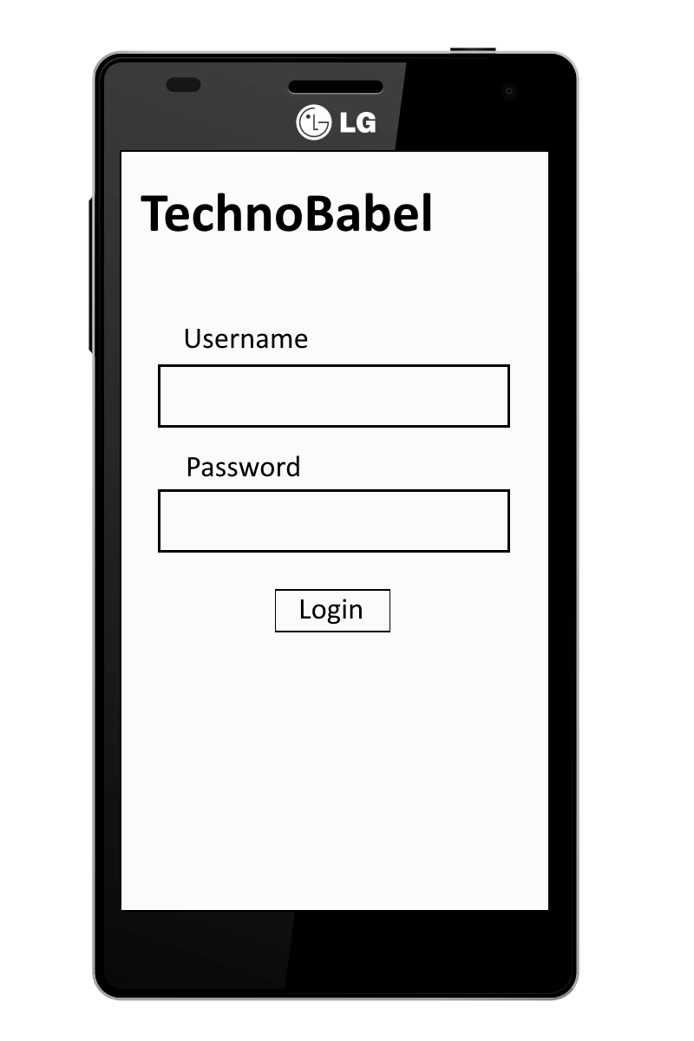
Demonstration

Slide 5

Project Purpose, Scope, Objective
Mobile Platform
Speech to text capabilities - i.e capturing terminology during meetings.
Dictionary Database List
Login Credentials
Administration Functionalities

Slide 6

Team Roles
Team Lead: Keith Zane
Front-End Lead: Bryan Robinson
Back-End Lead: Keith Zane
QA Lead: Bryan Robinson
Presentation Lead: Justin Stryjewski
Documentation Lead: Chris You

Slide 7
Problem Resolution Policies
Dispute Policy
Disputes amongst team members.
Technology Policy
Choosing specific technology
Attendance Policy
All team members are required to attend meetings with TA/Client
Code Quality/Deadline Policy
Organized, quality code
Submit code before team designated deadline.

Slide 8
Project Plan
Meetings with the Client Every Week
Weekly Iterations starting on monday ending on saturday
Monday Discussions about current week workload
Meetings Daily during the week
Saturday Discussions about previous week and goals for future week

Slide 9
Configuration Management
Task management amongst team members
Distribute and contribute equally
Source control
Github
Featured branch workflow
Branches for individual features

Slide 10
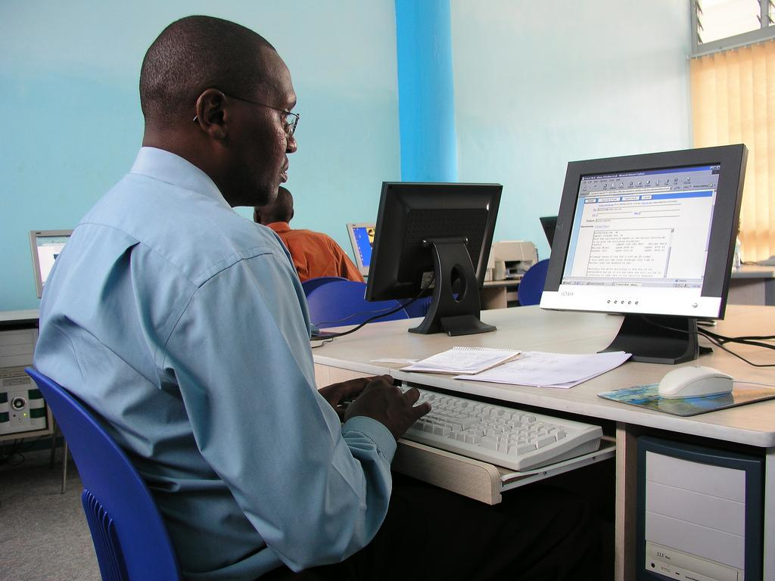
Technology Stack
Frontend development
Xamarin
C#
Backend development
ASP.NET
C#
Microsoft Azure
SQL Server
Microsoft Bot Language Framework

Slide 11
Questions?

